Slide 1

AUDIO MODIFICATION
HUSNA NOOR

Slide 2
INDRODUCTION
The project is about combining two mp3 files taken from user and creating an output file.
The user have an option for which file to play.
The output file can be paused play and stopped.

Slide 3
LIBRARIES
The libraries we used include following:
#include <stdlib.h>
standard C library
#include <unistd.h>
unix standard library
#include <stdio.h>
standard input output library

Slide 4
#include <errno.h>
for error handling
#include <fcntl.h>
contains constructs that refer to file control
#include <sys/types.h>
defines data types used in source codes
#include <string.h>
used for string handling
#include <sys/wait.h>
makes the system wait

Slide 5
ALGORITHM
3 inputs are taken from user from command line
File1, file2 and result file are created of integer type
For file1:
the first argument is given
read write permission is granted.
For file2
the second argument is given
read write permission is granted.

Slide 6
For result file:
the third argument is given
read write permission is granted
a new file is also created
Data is read from file1 and written on resultant file.
Data from file2 is read and written at the end of resultant file.
A new combined file is created.

Slide 7
The user is asked for, whether to play the files or not
Option of 3 file is presented, for which file to play, or to quit
User can continue to play the song, or can stop

Slide 8
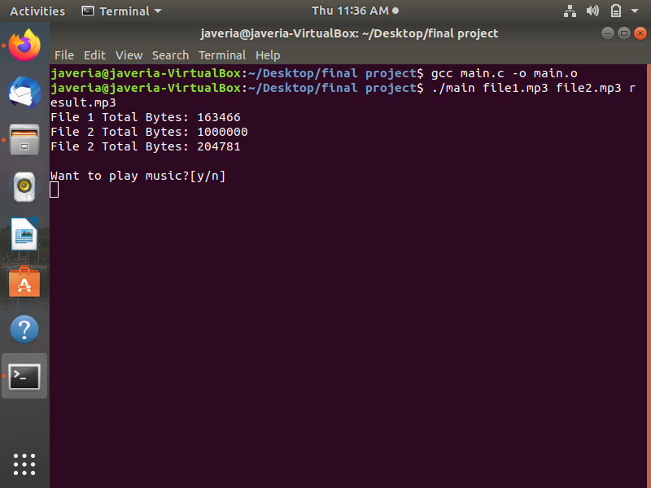
Pictures make it more clear ☺
Because seeking permission is important ;)

Slide 9
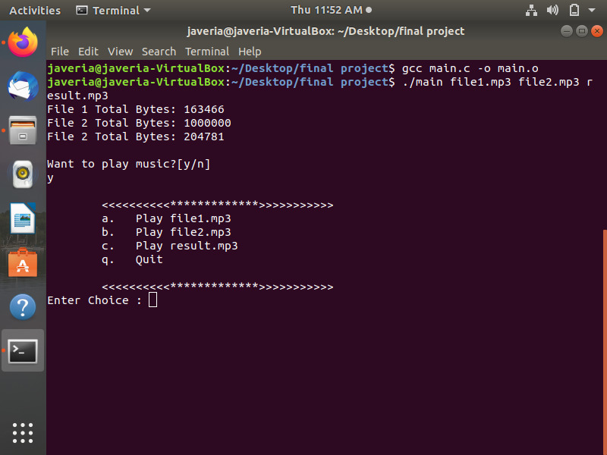
☺
Your choice really really matters!

Slide 10
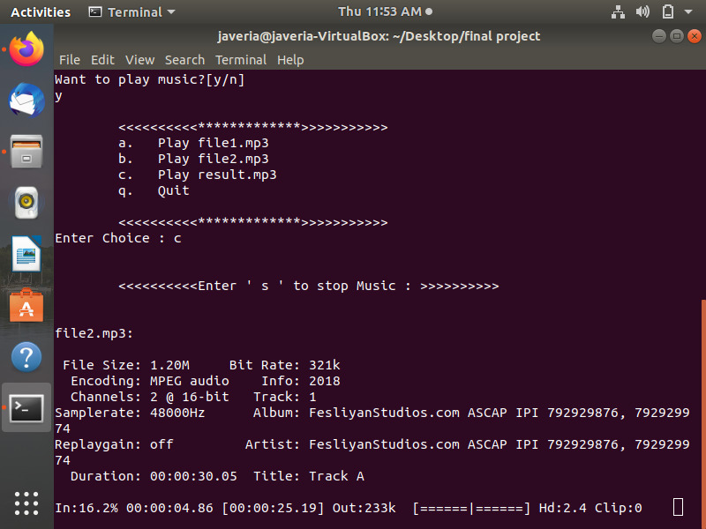
Oops!
Didn’t like the music , no problem, just stop it!

Slide 11
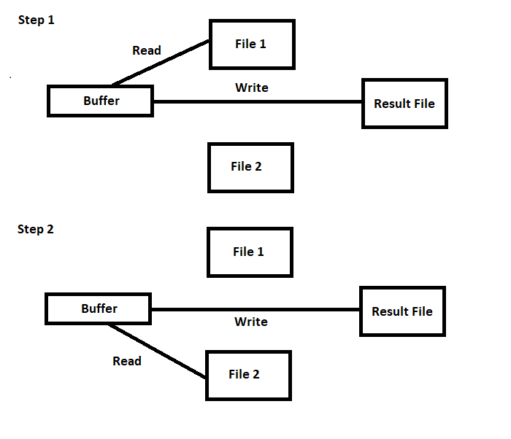
FLOW CHART

Slide 12
Thanks! ☺

